Slide 1
OOP Exceptions
Unit 9: try, catch and Exceptions: the basic mechanisms
Unit 10: making code more robust

Slide 2
Related Material, both units
Horstmann Ch 7
Sample Programs (both units) AgeInput1-5, AgeInputException, Manager2, Manager2Test1_3, Employee
Extra programs for labs: CountingButton, ExceptionPropagator, ChristmasList8, Gift

Slide 3
Unit 9: Exception basics
At the end of this unit, you should be able to
Describe java’s exception-handling mechanism, and distinguish between checked and runtime exceptions
Use try and catch to deal with exceptions, ordering catch clauses appropriately
Explain the purpose of a ‘finally’ block
Explain how uncaught exceptions are propagated back up the method call stack.
Declare uncaught checked exceptions in method headers

Slide 4
Java Exception Objects
An Exception is an object that contains information about the error that has occurred. If something goes wrong within a method, the method “throws” an exception object. The client can “catch” this object or “throw” it without handling it.

Slide 5
Why Exceptions?
In some programming languages, problems are avoided by constant checking using blocks of ‘if’s within ‘if’s
This can make a program long, complex and hard to debug
Java avoids this by throwing exceptions when a problem is encountered
The API has a hierarchy of error and exception classes
Notes:
We can increase our programs’ reliability and robustness if we catch the exceptions ourselves using error recovery routines we develop.
One way to do this is to wrap the statements that may throw an exception with the try-catch control statement.

Slide 6
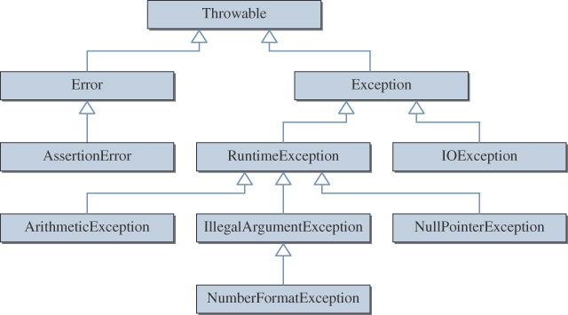
Throwable Hierarchy
There are over 60 classes in the hierarchy.
Notes:
The classes shown here are some of the more common classes in the Throwable class hierarchy. We will be seeing most of the Exception and its subclasses shown here in the later modules.

Slide 7
Another View
Object
Throwable
2.
Internal
errors
,
3.
These
exceptions
have
nothing
to do
to be
handled
with try
and
catch
, or
they
should
be
Exception
Error
thrown
out
of
the
method
. . .
. . .
VirtualMachineError
. . .
IOException
SQLException
RuntimeException
1.
Try
to
write the
programs
so
that these exceptions
don’t occur
.
ArithmeticException
NullPointerException
. . .

Slide 8
Errors
You can do little about Errors
They arise from problems within the Java Virtual Machine
They are outside the scope of this module

Slide 9
Exceptions
An exception represents an error condition that can occur during the normal course of program execution.
When an exception occurs, or is thrown,
The normal sequence of flow is terminated.
If there is an exception-handling routine in place, it is executed; we say the thrown exception is caught.
If there is no exception-handling routine in place, the program crashes, usually with a cryptic multi-line error message.
Notes:
We can increase our programs’ reliability and robustness if we catch the exceptions ourselves using error recovery routines we develop.
One way to do this is to wrap the statements that may throw an exception with the try-catch control statement.

Slide 10

Throwing an Exception
When something goes wrong, the program pulls the emergency cord that stops the train..

Slide 11
Advantages of the Java approach
Each method signals problems which arise within it by throwing exceptions
Calling methods can decide to ignore some of these possible problems, deal with others, and throw some back to their own calling method

Slide 12
Why not handle the problem within the method?
The parseInt method knows that the String it’s parsing doesn’t correspond to an integer
It doesn’t have enough information to decide what to do about it: should the program stop, or should the user be asked to try again?
So it throws an exception, and leaves the decision to its invoking method

Slide 13
Common Exceptions
Examples of exceptions that a program should be able to handle without aborting include
attempting to divide by zero,
getting the square root of a negative number,
attempting to read a floating-point number or text into an int variable
trying to access an element of an array outside its bounds.

Slide 14
Exercise
Examine the documentation for the class RuntimeException, and in particular the list of known direct subclasses. Identify which of these is most likely to be thrown for each of the operations listed on the previous slide.
If you can’t guess, write a short tester program to find out.

Slide 15
Exceptions when communicating with Files
Many things can go wrong when dealing with files:
the file could be damaged
it could be read-only so you aren’t allowed to write to it
its name could be misspelt by you
you might be referring to the wrong device (e.g. USB key instead of hard disk)
you may have reached the end of the file etc etc.

Slide 16
Checked vs. Runtime Exceptions
There are two types of exceptions:
Checked.
Unchecked, or runtime.
A checked exception is an exception that is checked at compile time.
All other exceptions are unchecked, or runtime, exceptions. As the name suggests, they are detected only at runtime.

Slide 17


You can ignore runtime Exceptions
There’s no law that forces these folks to wear a helmet
If they crash, tough…

Slide 18
Ignoring RuntimeExceptions
String inputStr;
int age;
// user enters “ten” as text
inputStr = JOptionPane.showInputDialog("Age:");
age = Integer.parseInt(inputStr);
Error message for invalid input
java.lang.NumberFormatException: ten
at java.lang.Integer.parseInt(Integer.java:405)
at java.lang.Integer.parseInt(Integer.java:454)
at AgeInput1.main(AgeInput1.java:20)
// AgeInput1
Notes:
Consider the given example. What would happen if the user enters a value such as the text 'ten' instead of 10? The parseInt method cannot convert such an input to an internal numerical format. This type of error is called an exception, and it will result in displaying an error message such as the one shown here. We say the parseInt method has thrown a NumberFormatException.

Slide 19
Catching runtime exceptions makes a program more user-friendly
Up to now, we have ignored things like NumberFormatExceptions
You have the option of handling them, generating a more understandable error message, and possibly allowing the user to try again

Slide 20

You must deal with or declare checked Exceptions
If you enter for a competition, there are safety rules about helmets:
If the cyclist crashes, the organisers will have done their best to avoid a broken skull.

Slide 21
The compiler forces you to acknowledge checked Exceptions
When calling a method that can throw checked exceptions you must either:
catch them by using try-catch, placing the call in the try block, or
declare them, by modifying the method header to include the appropriate throws clause (passing the buck back to the invoking method).

Slide 22
Persistence operations generate checked Exceptions
Constructing stream objects for input or output can generate checked exceptions (IOException, FileNotFoundException)
Using stream objects to write / read data to/from files can generate checked exceptions
Certain type casts applied to objects read from file can generate checked Exceptions
All of these must be caught or declared to be thrown

Slide 23
Declaring an IOException in a method header
save() method
public void saveData() throws IOException {
ObjectOutputStream os;
os = new ObjectOutputStream(new FileOutputStream
("bikes.dat"));
os.writeObject(bikes);
os.close();
}
passes the problem back to the calling method, which can catch it, or throw it back to main

Slide 24
Not catching the IOException
If no method handles the exception, it must be declared to be thrown from main
public static void main (String args[])
throws IOException{
…..
saveData();
}
A problem might never arise on saving, but if it does…

Slide 25


Catching Exceptions: making something happens when the program presses the panic button
Grandmother pushes the panic button:
Garda car is dispatched to help her

Slide 26
Mechanism for catching Exceptions
Enclose
the code which might generate a problem
any following code which depends on its successful completion
within a try {} block
Follow by one or more catch{} blocks
Each catch{} block deals with a specific type of Exception

Slide 27
NumberFormatExceptions
When a user enters an inappropriate type in response to a data entry request, such as text instead of a double
The parsing process (eg Double.parseDouble()) can’t make sense of the value, so it throws a NumberFormatException
You can’t do much about the user input
But you can catch the exception, avoiding a program crash and the system error message

Slide 28
Catching NumberFormatException
inputStr = JOptionPane.showInputDialog(null, "Age:");
try {
age = Integer.parseInt(JOptionPane.showInputDialog(
“Enter your age”);
// maybe the program presses the panic button
}
catch (NumberFormatException e){
// instead of crashing, we get a nice message
JOptionPane.showMessageDialog(null, "’" + inputStr
+ "‘ is invalid\n"
+ "Please enter digits only");
} // AgeInput2
try
catch
Notes:
This example shows a way to handle a thrown exception in our code, instead of letting the system handle it, as in the previous example. If any statement inside the try block throws an exception, then the statements in the matching catch block are executed. And the program continues the execution from the statement that follows this try-catch statement.

Slide 29
When catching NumberFormatException
If you want to give the user a chance to re-enter the value, and your program is not event-driven
Use a boolean variable, initially false, to control a do-while loop surrounding the try –catch blocks
Inside the try block, set the variable to true as the last statement: the program will only get there if no exception has been thrown
It’s not a good idea to ask for user input within the catch block
If your program is event-driven, it might be less complicated to display a message, then let the user trigger re-entry by clicking the button or menuitem again

Slide 30
A validation loop surrounding a try-catch block // AgeInput3
boolean valid = false;
while (!valid) {
inputStr = JOptionPane.showInputDialog(“Age:");
try {
age = Integer.parseInt( inputStr);
valid = true;
} catch (NumberFormatException e){
// instead of crashing, we get a nice message
JOptionPane.showMessageDialog(null, "‘ invalid\n"
+ "Please enter digits only"
} // end catch
} // end while: if not valid, we repeat the try block
try
catch
Notes:
This example shows a way to handle a thrown exception in our code, instead of letting the system handle it, as in the previous example. If any statement inside the try block throws an exception, then the statements in the matching catch block are executed. And the program continues the execution from the statement that follows this try-catch statement.

Slide 31
Catching IOException
public static void main (String args[]) {
….
try{
saveData();
showMessage("Data saved successfully");
} // try
catch (IOException f){
showMessage("Not able to save the file:\n“);
f.printStackTrace(); // temp, for debugging
}// catch

Slide 32
Exercise
Examine the java docs for the class NumberFormatException:
Does it have any subclasses?
What is its immediate superclass?
Would it be equally useful to catch the superclass in AgeInput2?

Slide 33
Getting Information about what caused the Exception
There are two methods we can call to get information about the thrown exception: getMessage() and printStackTrace()
getMessage() gives us the message that was generated when the exception object was created
if we define our own exception classes (unit 10) we can specify the wording of this message
we can display it in a dialog or on the console
Notes:
In the previous example, we simply displayed a fixed error message. We can get display a more generic error message by using the getMessage or printStrackTrace methods. We will experiment with these methods in the lab.

Slide 34
printStackTrace()
gives you the standard error printout on the console
It helps when you are testing a program, as you get a lot of information as to what might have caused the problem (look at the top line first)
You should remove printStackTrace() once the program has been fully tested.

Slide 35
Is the catch always executed?
If nothing goes wrong while executing the try{} block, all the catch blocks are ignored
If something does go wrong, the try{} block is abandoned, and control transfers to the first matching catch block
If there is no matching catch block, the exception is ‘propagated’ back up the method stack

Slide 36
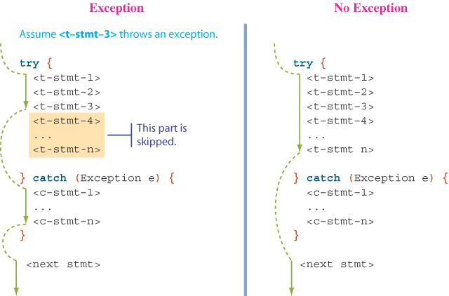
try-catch Control Flow
Notes:
This illustrates how the control flows when there is an exception and when there is no exception.
In the case when no statements in the try block throw an exception, then the catch block is skipped and execution continues with the next statement following the try-catch statement.
If any one of the statements throws an exception, the statements in the catch block are executed. Execution then continues to the statement following the try-catch statement, ignoring any remaining statements in the try block.

Slide 37
One try { }, many catch { }
Exception-generating code is placed in one try block
The try block can be followed by several catch blocks
The first catch block which matches is executed
If an exception is thrown, and there is no matching catch block anywhere in the method chain, the program crashes

Slide 38
Granny pushes the panic button
// First catch block UserWrittenException
Daughter’s phone rings …
// Second catch block NumberFormatException
Neighbour’s phone rings …
// Third catch block Exception
Gardaí called out

Slide 39
The order is important
If
catch (Exception g) {
callOutGarda();
}
is the first catch block, this will be executed and neither daughter nor neighbour will be called.

Slide 40
Multiple catch Blocks
try {
. . .
age = Integer.parseInt(inputStr);
. . .
val = cal.get(id); //cal is a GregorianCalendar
. . .
} catch (NumberFormatException e){
. . .
} catch (ArrayIndexOutOfBoundsException e){
. . .
}
Notes:
In this example, we see two statements in the try block that can potentially throw exceptions. The parseInt method throws a NumberFormatException while the get method throws an ArrayIndexOutOfBoundsException when the argument id is outside the range of valid values.

Slide 41
Only one catch block is executed
The first matching catch block is the only one executed
Order catch blocks from the most specific to the most general
And from the most likely to the least likely
catch (Exception e) {} catches everything: if you use it, this should be the last catch

Slide 42
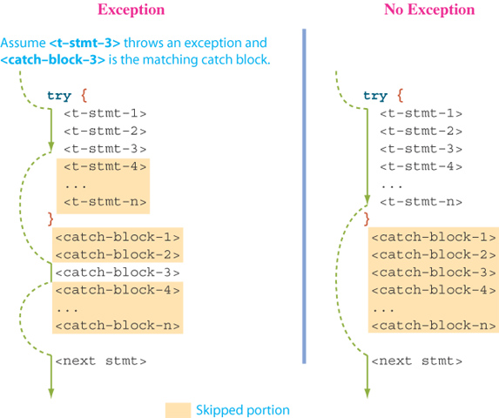
Multiple catch Control Flow
Notes:
Here's how the control flows when there are multiple catch blocks.
In the case when no statements in the try block throw an exception, then all catch blocks are skipped and execution continues with the next statement following the try-catch statement.
If any one of the statements throws an exception, the statements in the matching catch block are executed. Execution then continues to the statement following the try-catch statement, ignoring any remaining statements in the try block.

Slide 43
The finally Block
There are situations where we need to take certain actions regardless of whether an exception is thrown or not.
We place statements that must be executed regardless of exceptions in the ‘finally’ block.
Notes:
The finally block is not used often in introductory level programs, but we will introduce them here for the sake of complete coverage of the topic. For example, suppose we open a communication channel from our Java program to a remote web server to exchange data. If the data exchange is successfully completed in the try block, then we close the communication channel and finish the operation. If the data exchange is interrupted for some reason, an exception is thrown and the operation is aborted. In this case also, we need to close the communication channel, because leaving the channel open by one application blocks other applications from using it. The code to close the communication channel should therefore be placed in the finally block.

Slide 44
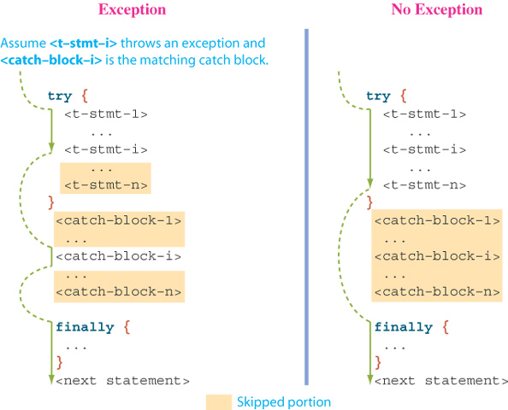
try-catch-finally Control Flow
Notes:
Here's how the control flows when there are multiple catch blocks and the finally block.
In the case when no statements in the try block throw an exception, then all catch blocks are skipped, but the statements in the finally block are executed. Execution continues with the next statement following the try-catch statement.
If any one of the statements throws an exception, the statements in the matching catch block are executed first and the statements in the finally block are executed next. Execution then continues to the statement following the try-catch statement, ignoring any remaining statements in the try block.

Slide 45
Why use ‘finally’?
Use ‘finally’ blocks to handle tidying up that must happen in all cases
FileReader reader = new FileReader(filename);
try{
Scanner in = new Scanner(reader);
readData(in);
}
// possible catch blocks, then
finally {
reader.close();
}
This ensures that the file will be closed under all circumstances, whether or not an exception is thrown

Slide 46
When handling Exceptions
Make sure you include in the ‘try’ block all actions which should not be attempted if a previous action has gone wrong
If you can’t open the file, you shouldn’t try to write an object to it

Slide 47
Propagating Exceptions
Instead of catching a thrown exception by using the try-catch statement, we can propagate the thrown exception back to the caller of our method.
The method header includes the reserved word throws.
public int getAge( ) throws NumberFormatException {
. . .
int age = Integer.parseInt(inputStr);
. . .
return age;
}
// AgeInput4
Notes:
Using the try-catch statement is the first way to handle the exceptions. The second way is to propagate the thrown exception back to the caller of the method. The method that includes the statement that calls our method must either catch it or propagate it back to their caller.

Slide 48
Handling the thrown exception further up the call stack:
public static void main (String args[]){
int age;
try {
age = getAge("Please enter your age: ");
JOptionPane.showMessageDialog(null,"age " +
age);
}
catch (NumberFormatException e) {
JOptionPane.showMessageDialog(null,
"Please enter digits only");
} // end catch
}// end main

Slide 49
Exception Thrower
When a method may throw an exception, either directly or indirectly, we call the method an exception thrower.
Every exception thrower must be one of two types:
catcher.
propagator.
Notes:
We say a method throws an exception directly when the method includes the throw statement. Otherwise, a method is throwing an exception indirectly.

Slide 50
Types of Exception Throwers
An exception catcher is an exception thrower that includes a matching catch block for the thrown exception.
An exception propagator does not contain a matching catch block.
A method may be a catcher of one exception and a propagator of another.

Slide 51
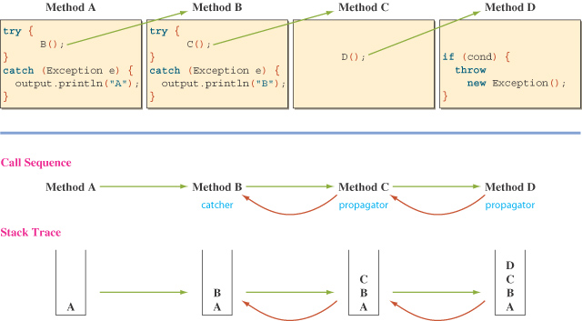
Sample Call Sequence (see ExceptionPropagator.java)
Notes:
This illustration shows a sequence of method calls among the exception throwers.
Method D throws an instance of Exception. The green arrows indicate the direction of calls. The red arrows show the reversing of call sequence, looking for a matching catcher. Method B is the catcher.
The call sequence is traced by using a stack.

Slide 52
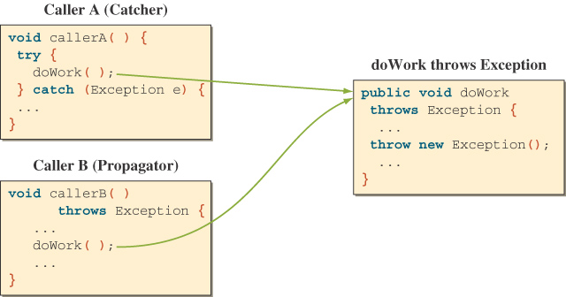
Handling Checked Exceptions
Notes:
Callers of a method that can throw a checked exception must include the try-catch statement in the method body or the throws clause in the header.

Slide 53
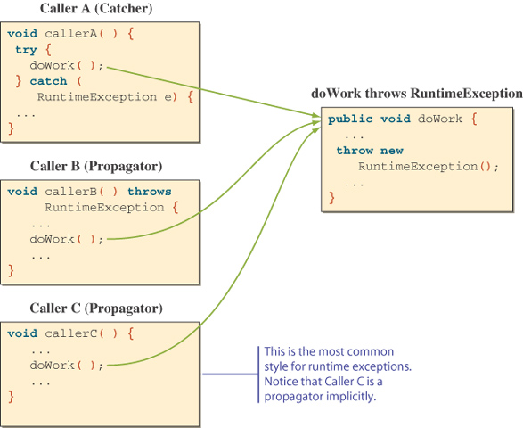
Handling Runtime Exceptions
Notes:
It is optional for callers of a method that can throw runtime exceptions to include the try-catch statement in the method body or the throws clause in the header.

Slide 54
Unit 10: using exceptions to make code more robust
At the end of this unit, you should be able to
Write more robust methods and classes by validating user input and throwing exceptions where appropriate
Write your own Exception classes by extending one of the existing Exceptions

Slide 55
Throwing Exceptions
We can write a method that throws an exception directly, i.e., this method is the origin of the exception.
Use the throw reserved word to create a new instance of the Exception or its subclasses.
The method header includes the reserved word throws.
public void doWork(int num) throws Exception {
. . .
if (num > val) throw new Exception("Invalid val");
. . .
}
// see Manager2.java setWeeklySalary method
Notes:
It is possible to throw an exception from our own method.

Slide 56
Why do this?
We could have forced the user to enter a valid value by putting a loop within the doWork() method: while (num > val){
Sometimes it’s easier just to throw an exception, and leave it to the user to select the relevant ‘enter data’ button or menu item again

Slide 57
We can tailor the Exception’s message:
Exception constructors allow us to supply a string, which becomes the message supplied by calls to e.getMessage() within the catch:
try{
…
if (num > val) throw new Exception(“Value should be between 1 and 10");
}
catch (Exception e){
System.out.println(e.getMessage()); }

Slide 58
What kind of Exception should we throw?
For input validation, throw a runtime exception like a NumberFormatException or an IllegalArgumentException, or a user-written subclass

Slide 59
User-written Exception subclasses
Using the standard exception classes, we can use the getMessage method to retrieve the error message.
By defining our own exception class, we can pack in more useful information
for example, we may define an OutOfStock exception class and include information such as how many items to order
AgeInputException (see AgeInput5.java getAge() method) is defined as a subclass of Exception and includes public methods to access its three attributes: lower and upper bounds of valid age input and the (invalid) value entered by the user.

Slide 60
Making ‘set’ methods and constructors more robust by throwing Exceptions
‘Set’ methods in instantiable classes should ensure that attributes are not set to unsuitable values
‘set’ methods can return a boolean to denote whether the value was changed as a result of the method (using an ‘if’ to see whether the value should be changed): the invoking application must then check this return value.
There are two problems with this:
If the invoking app doesn’t check, the problem may go un-noticed
‘set’ methods are often invoked by constructors, and constructors cannot return anything

Slide 61
Returning a boolean from a ‘set’ method
So far, we have handled checking values within set methods with actions like
if (salary > 0)
this.salary = salary;
It’s possible to write the ‘set’ method to return a boolean:
public boolean setSalary(double salary) {
if (salary > 0){
this.salary = salary;
return true; // salary changed
}
else
return false; } // salary unchanged
Any application that sets a salary has the option of checking the return value to see if it worked

Slide 62
Constructors can’t return anything
Constructors don’t have a return type, so
‘return false;’ is not an option when validating values
An alternative is to throw a customised exception, which the application can check within a try{} block, or ignore

Slide 63
Manager2: a better version of Manager
Manager2 is another subclass of Employee
Manager2s inherit first name and surname
Manager2s are paid a weekly salary
This weekly salary should be at least 600 euro
The constructor invokes setWeeklySalary() to set (and check) values supplied by programs which create Manager2 objects

Slide 64
The constructor invokes setWeeklySalary()
The setWeeklySalary() method will throw an IllegalArgumentException if the salary is too low
Any program which attempts to create a Manager2 object with a salary which is too low will cause the exception to be thrown

Slide 65
setWeeklySalary() from Manager2
public void setWeeklySalary(double sal){
if (sal < 600)
throw new IllegalArgumentException (
"Manager's salary must be at
least 600 euro");
weeklySalary=sal;
}

Slide 66
Avoiding underpaid Managers
Manager2 m1 = new Manager2(“Joe”,
“Soap”, 300.00);
// from ManagerTest1
The program will crash with an IllegalArgumentException
Where the salary is entered by the user, the application has the option to catch both ‘text’ errors and value range errors

Slide 67
Catching a Low Salary
try {
double salary = Double.parseDouble(
JOptionPane.showInputDialog(
"Salary: must be at least 600"));
m2 = new Manager2(fname,sname,salary);
JOptionPane.showMessageDialog(null,"Manager2 created successfully:\n “ +m2.toString());
}
catch (NumberFormatException e){ // text entered
JOptionPane.showMessageDialog(null,"Salary must be a number");
}
catch (IllegalArgumentException e){// too low
JOptionPane.showMessageDialog(null,e.getMessage());
} // from ManagerTest2

Slide 68
Allowing the user to re-enter, using a validation loop
boolean valid = false; // added
while (!valid) { // added
try {
double salary = Double.parseDouble
(JOptionPane.showInputDialog("Weekly Salary);
m2 = new Manager2(fname,sname,salary);
JOptionPane.showMessageDialog(null,“OK“);
valid = true; // added
} // end try
catch blocks as before
} // end while
// from ManagerTest3
Note: the loop is not inside the catch block

Slide 69
Useful in constructors
Where a constructor sets an attribute directly
An exception can be thrown if a value is inappropriate
The code will be similar to that in setWeeklySalary()
Where the constructor invokes a ‘set’ method, the ‘set’ method will throw the same exception
In either case, the catch block in the invoking application can be the same

Slide 70
Constructor which sets an attribute directly
public Manager2(String fn, String sm,double sal) throws IllegalArgumentException {
super(fn,sn);
if( sal < 600 )
throw new IllegalArgumentException( “
The salary must be at least EUR 600 “);
weeklySalary = sal;

Slide 71
Program Analysis
The Manager2 constructor contains the code that creates an IllegalArgumentException instance should such an exception arise.
If there is something wrong with the salary the Exception object is created and thrown to the calling method (main).
The main() method has try-catch functionality to deal with an IllegalArgumentException
The try surrounds all the code (user data entry, constructor call and reassurance message) that might generate an exception, or should not be executed in the event of an exception

Slide 72
What class of Exception should we throw?
It could be a NumberFormatException: but how would we distinguish data which was of the wrong type from data of the right type, but outside the acceptable range?
IllegalArgumentException is appropriate: it’s the superclass of NumberFormatException
Exception would be too general – it would work, but it would give us less knowledge of what went wrong: and it’s a checked exception, so all invoking applications would be forced to declare it.
What about an exception of our own?

Slide 73
Creating Application-specific Exception Classes
It is easy to create our own exception classes that we can use to make a program more personal and readable.
Simply create a subclass of any Exception class, and provide 2 constructors, one taking no arguments, the other taking a String argument which will be the textual information we wish to associate with the exception, should it occur.

Slide 74
class ManagerInvalidException
public class ManagerInvalidException extends IllegalArgumentException{
public ManagerInvalidException() {
super("Invalid employee data");
}
public ManagerInvalidException(String message) {
super(message);
}
}

Slide 75
This exception class can now be used in place of IllegalArgumentException:
public void setWeeklySalary(double sal){
if (sal < 600)
throw new ManagerInvalidException (
"Manager's salary must be at least 600 euro");
weeklySalary=sal;
}
Classes which create Manager2s or change their salaries may catch this exception, or ignore it, hoping it will never be thrown.
If it is thrown and the program crashes, the top line of the system error message will give the exception type as ManagerInvalidException

Slide 76
Catching in the driver program :
try {
double salary = Double.parseDouble(
JOptionPane.showInputDialog(
"Salary must be at least 600"));
m2 = new Manager2(fname,sname,salary);
}
catch (ManagerInvalidException e){// salary too low
JOptionPane.showMessageDialog(null,e.getMessage());
} // ManagerTest4: left to the student to write

Slide 77
Summary, Exceptions
To signal an exceptional condition, use the throw statement to throw an exception object.
When you throw an exception, the current method terminates immediately.
There are two kinds of exceptions: checked and unchecked. Unchecked exceptions extend the class RuntimeException.
Checked exceptions are due to external circumstances that the programmer cannot prevent. The compiler checks that your program handles these exceptions.
Add a throws specifier to the header of a method that can throw a checked exception, unless it will catch it itself.

Slide 78
Summary, Exceptions, more
In a method that is ready to handle a particular exception type, place the statements that can cause the exception inside a try block and the handler inside a catch clause.
It is better to declare that a method throws a checked exception than to handle the exception poorly (avoid generalised catch (Exception e){} )
You can design your own exception types as subclasses or Exception or RuntimeExceptoin

